Slide 1
Quick Base Craft Demo {Position you are interviewing for}
{Interview Date}

Slide 2
Agenda
We have one hour to get to know each other.
The first part of the interview is designed to generate a conversation. We want to know what is important to you and share what is important to us. Learnings and values are more important than details.
About Me Roughly 5 minutes to tell us about yourself and set some context.
Portfolio Accomplishments Showcase one or two career highlights. We should spend about 5 minutes on each.
Craft Demo You should spend about 15 minutes walking through the demo. The remaining 30 minutes is for discussion.
We have one hour to get to know each other.
The goal is to have a great conversation.

Slide 3
Hello.

Slide 4
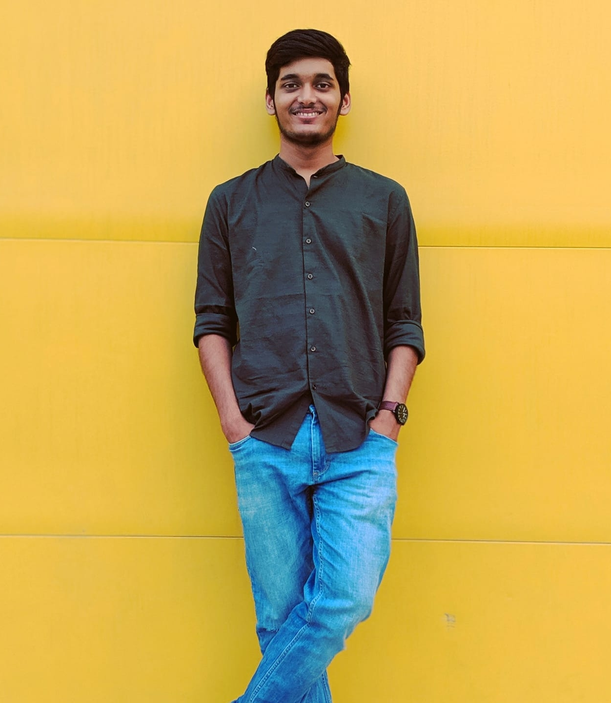
About Me
Name : Mrigesh Dasgupta
Major : MS in Information Systems (Northeastern University)
Worked as software developer for 3 years in IT company. Worked on backend technology like Java, SpringBoot and wrote REST API’s. Also developed projects using MEAN Stack
Skills:
Web Technologies : Angular, ReactJs, HTML5/CSS3/Bootstrap, jQuery.
Backend : SpringBoot, NodeJS, ExpressJs, Maven, JSP.
Programming Languages : Java, JavaScript, Typescript, SQL.
Cloud Technologies : Docker, Kubernetes.
Databases : MsSQL , MongoDB, DB2.
Testing & Frameworks : JUnit, Latex, mongoose.
.

Slide 5
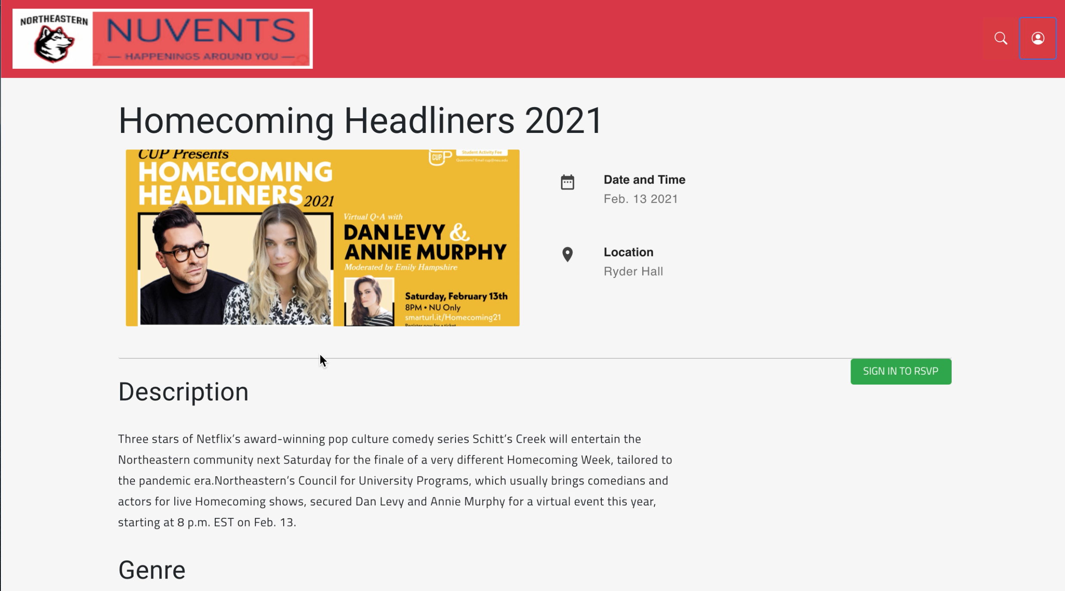
Portfolio > NUvents
Problem: Developed an event management website for university. Integration of all components with working functionality towards the end of the project. Worked in group of 4.
Results: Learned about how to implement full-stack programming using MEAN stack. Learned to work in a group project and support each other. Tech stack will help to for future job opportunities.

Slide 6
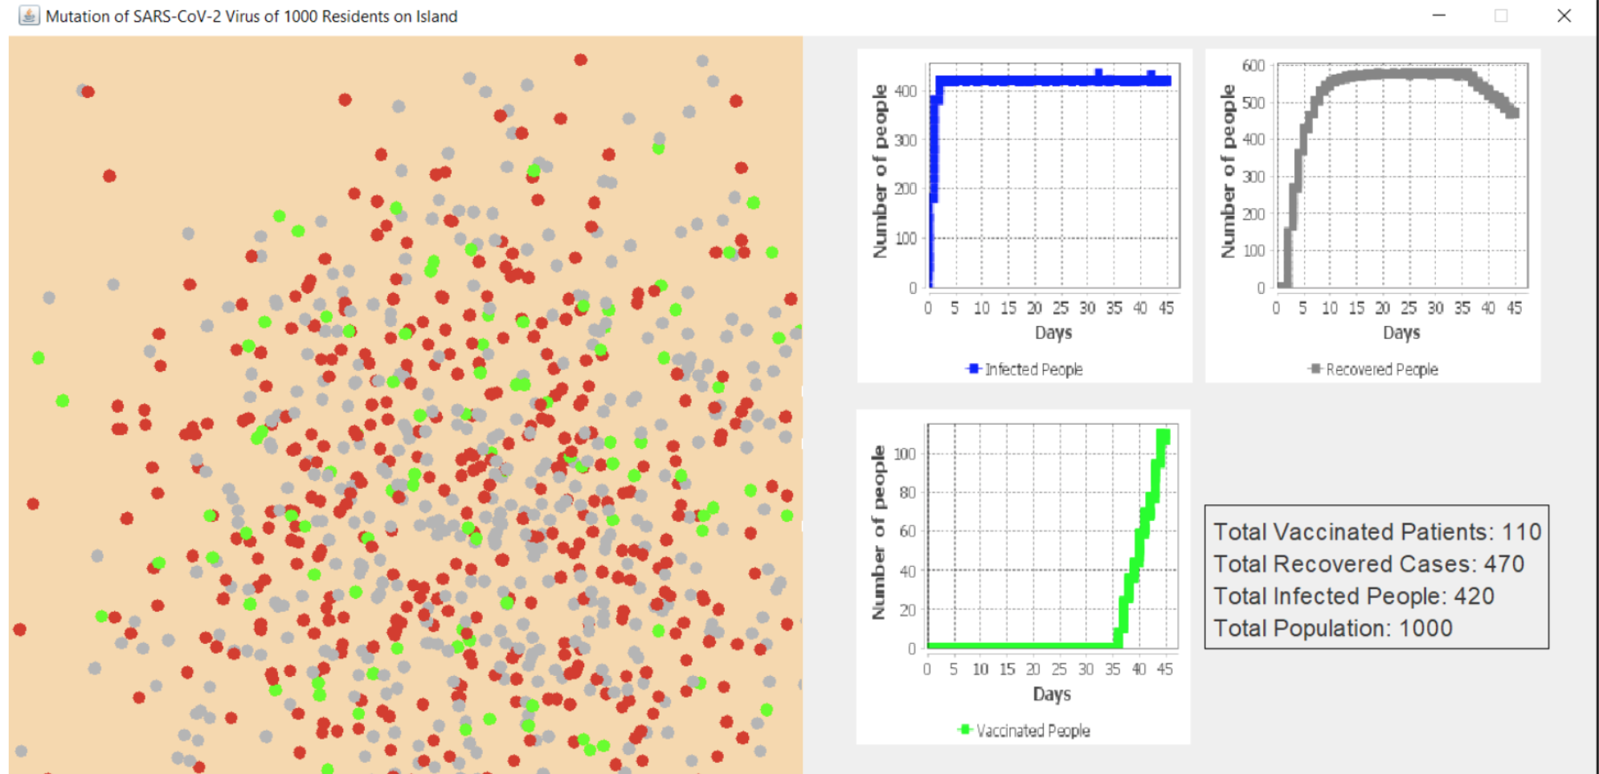
Portfolio > Virus Evolution Simulation
Problem: To simulate the mutation and evolution of Covid-19 virus for algorithms project. Required prior knowledge of human genetics and protein bases. Worked in group of 3 members.
Results: Studied and did research of the of human genes and virus genome. Implemented and showed simulation using UI and dynamic graphs

Slide 7
Craft Demo and discussion

